Slide 1

Obstacle Avoiding Robot

Slide 2

GOVERNMENT POLYTECHNIC NAGPUR (An Autonomous Institute of Government of Maharashtra)
Mini Project Topic : Obstacle Avoiding Robot
Group Members
1. Chirag Pabari 1904044
2. Yugal Nasare 1904042
3. Ganesh Moroliya 1904038
4. Atharva Navghare 1904043
5. Pawan Sorte 1904058
Guided by _Prof. Arshi Anjum
DEPARTMENT OF
ELECTRONICS AND TELECOMMUNICATION ENGG.
Academic Session 2021-2022

Slide 3
CONTENT
Introduction
Project Objective
Component Used
Components Details
Construction
Circuit Diagram and Working
Program Used
Advantages And Disadvantages
Application
Conclusion

Slide 4
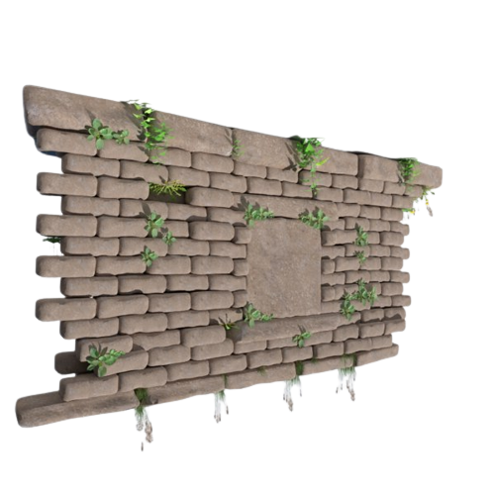
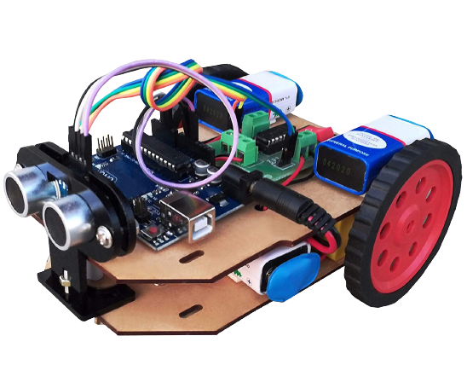
INTRODUCTION
Obstacle Avoiding Robot is an intelligent device that can automatically sense the obstacle in front of it and avoid them by turning itself in another direction.
Generally obstacle avoidance robot is design to allow robot to navigate in unknown environment by avoiding crash.
This robot senses obstacles in the path, and avoids it and resumes its running.

Slide 5
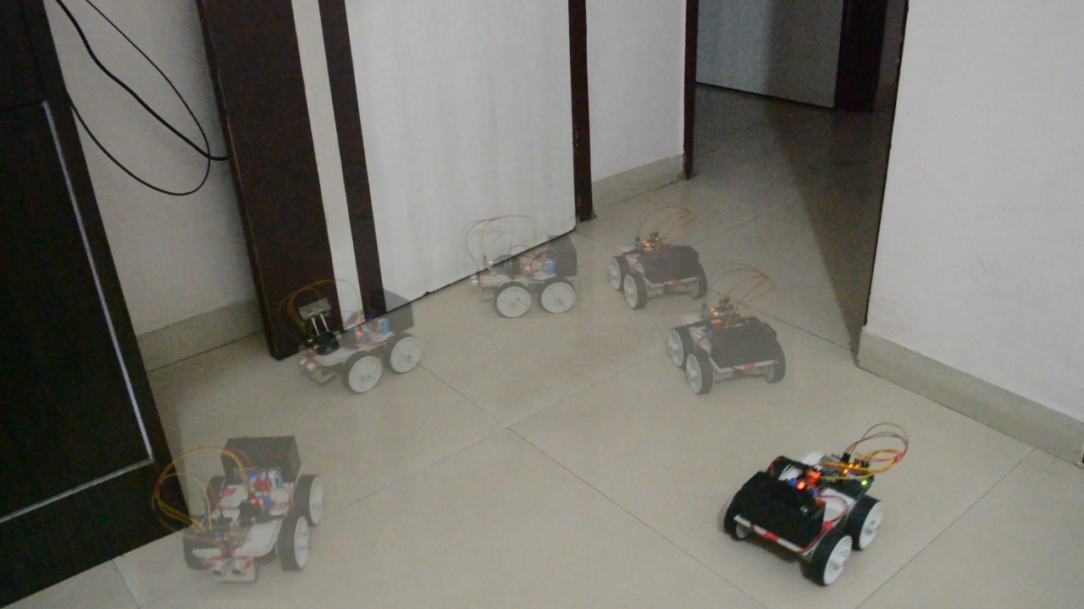
Project Objective
In Automatic Mode there are Robot will be capable of moving freely avoiding all the obstacle in there paths.
Obstacles can be avoided using sensors.

Slide 6
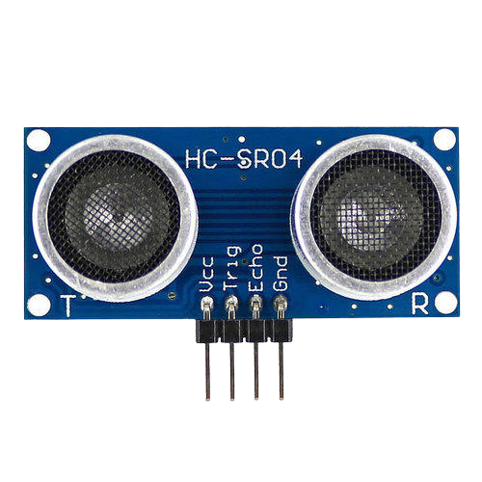
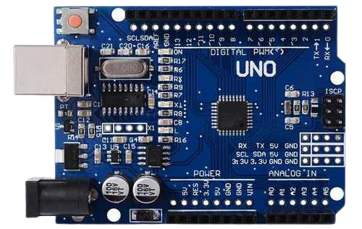
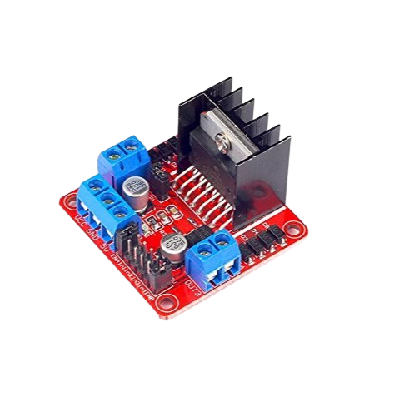
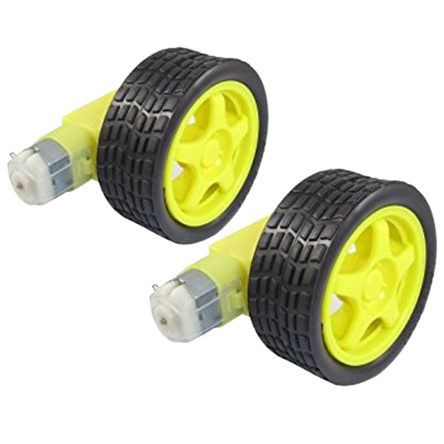
Components Use
Arduino UNO
Ultrasonic Sensor
L298N Motor Driver Module
BO Motor

Slide 7
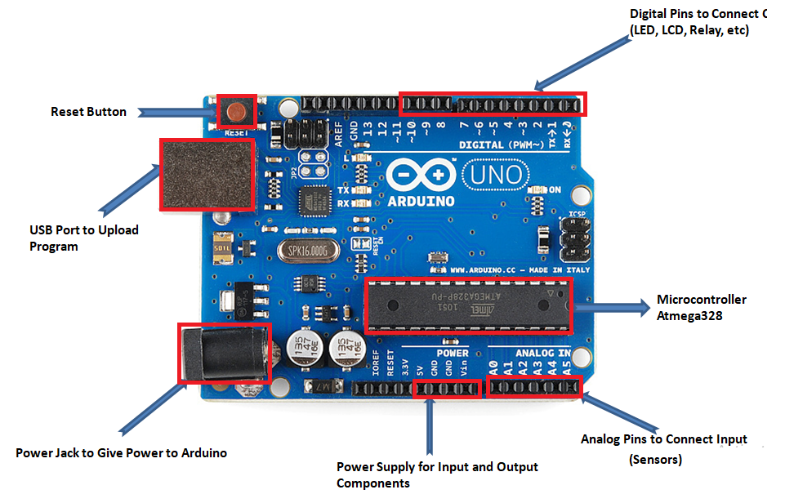
Components Details
Arduino UNO is a low-cost, flexible, and easy-to-use programmable open-source microcontroller board that can be integrated into a variety of electronic projects.
And it is open-source microcontroller board based on the Microchip ATmega328P.
Operating Voltage: 5V
Input voltage: 5 To 12v

Slide 8
Ultrasonic Sensor
An ultrasonic sensor is an instrument that measures the distance to an object using ultrasonic waves.
This sensor uses a transducer to send and receive ultrasonic pulses that replay back information about an object proximity.
Ultrasonic sensors are suitable for close range detection up to 10 meters and provide multiple range measurements per second.

Slide 9
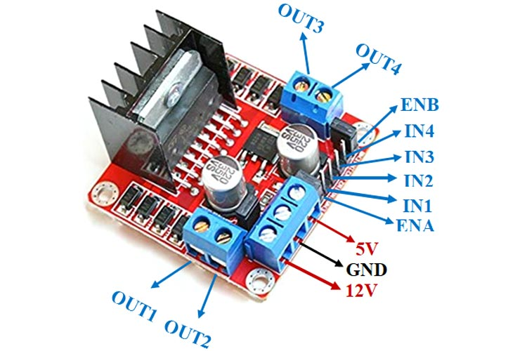
Motor Driver Module
The L298N is a dual H-Bridge motor driver which allows speed and direction control of two DC motors at the same time.
The module can drive DC motors that have voltages between 5 To 35V
Function of motor drivers is to take a low-current control signal and then turn it into a higher-current signal that can drive a motor.

Slide 10
BO Motor
Bo motor (Battery Operated) lightweight DC geared motor which gives good torque and rpm at lower voltages.
This motor can run at approximately 150 rpm when driven by a single Li-Ion cell.
Operating Voltage : 3 To 12 v
Load Current : 125mA (max.170mA)

Slide 11
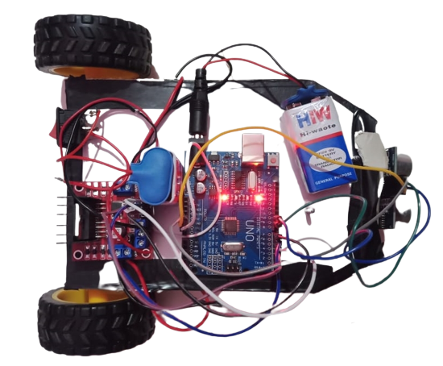
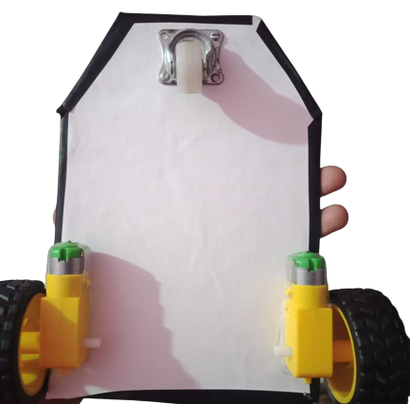

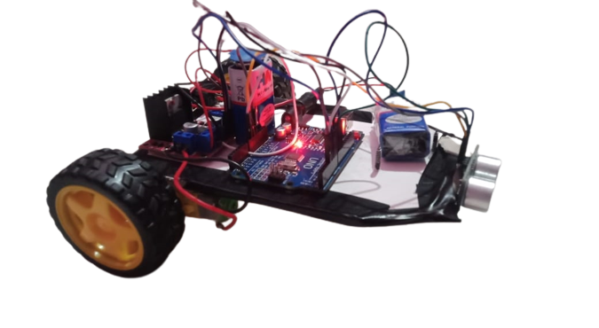
Construction

Slide 12
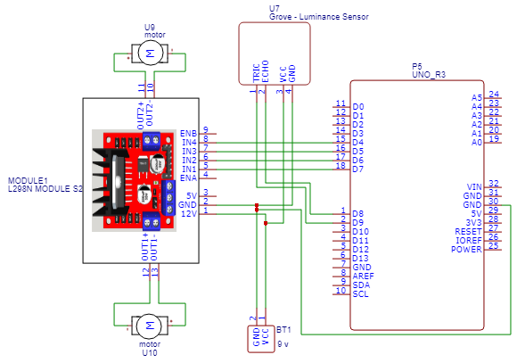
Circuit Diagram And Working
The obstacle avoidance robot uses ultrasonic sensors for its movements. A microcontroller is used to achieve the desired operation.
The motors are connected through the motor driver IC to the microcontroller And the ultrasonic sensor is attached in front of the robot.
Whenever the robot is going on the obstacle then ultrasonic sensor transmits the ultrasonic waves continuously from its sensor.
Then if obstacle comes ahead of it the ultrasonic waves are reflected from an object and that information is passed to the microcontroller.
The microcontroller controls the motors left, right, back, front, based on ultrasonic signals.

Slide 13
Program Used
int trigPin = 9;
int echoPin = 10;
int revright = 4; //REVerse motion of Right motor
int fwdright= 5; //ForWarD motion of Right motor
long duration, distance;
digitalWrite (trigPin,HIGH);
duration=pulseIn(echoPin, HIGH);
distance =(duration/2)*29.1;
delay(10);
if(distance>20)
{
digitalWrite(5,HIGH);
digitalWrite(4,LOW);
}
else (distance<20)
{
digitalWrite(5,LOW);
digitalWrite(4,HIGH);
}

Slide 14
Advantages And Disadvantages
Advantages :
Disadvantages :
Whenever robot senses any obstacle automatically diverts its position to left or right and follows the path without human guidance.
The programming of the microcontroller is easy.
It is a low’ cost circuit.
It is time consuming project.
It is use for short distance only.
It is not recommended to keep the range very long because this would cause the ROBOT to keep moving forward and backward as it senses any obstacle, even far away from it.
It is not in human control.

Slide 15
Applications
The obstacle avoidance robotics is used for detecting obstacles and avoiding the collision.
They can be used for household work like automatic vacuum cleaning.
They can also be used in dangerous environments, where human penetration could be fatal.
The Obstacle avoiding robots can be used in almost all mobile robot navigation systems.

Slide 16
Conclusion
Obstacle detection circuit was successfully implemented using ultrasonic sensors modules which were placed at the front of the robot to throw both Ultrasonic waves at any obstacle and when a reflection is received Then as you know Arduino is a Brain of robot they program ourself and implement it.

Slide 17

THANK YOU

